Slide 1
Deep Image Segmentation

Slide 2
Image Segmentation
Image segmentation is a sub-domain of computer vision and digital image processing that aims to group similar regions or segments of an image under their respective class labels.
Since the entire process is digital, a representation of the analog image in the form of pixels is available, making the task of forming segments equivalent to that of grouping pixels.

Slide 3
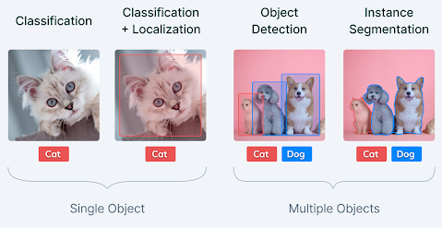
Image Segmentation
Image segmentation is an extension of image classification where, in addition to classification, we perform localization.
Image segmentation thus is a superset of image classification with the model pinpointing where a corresponding object is present by outlining the object's boundary.

Slide 4
Image Segmentation
In computer vision, most image segmentation models consist of an encoder-decoder network as compared to a single encoder network in classifiers.
The encoder encodes a latent space representation of the input which the decoder decodes to form segment maps, or in other words maps outlining each object’s location in the image.
A typical segment map looks something like this:

Slide 5
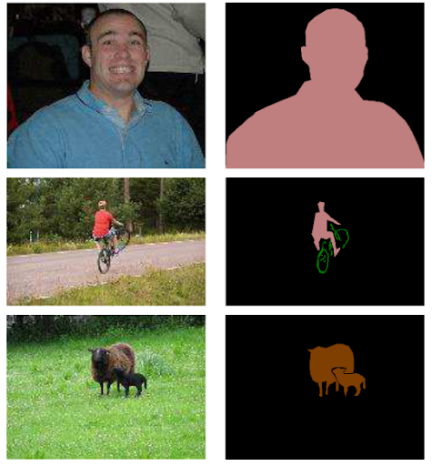
Image Segmentation

Slide 6
Types of Image Segmentation tasks
Image segmentation tasks can be classified into three groups based on the amount and type of information they convey.
While semantic segmentation segments out a broad boundary of objects belonging to a particular class, instance segmentation provides a segment map for each object it views in the image, without any idea of the class the object belongs to.
Panoptic segmentation is by far the most informative, being the conjugation of instance and semantic segmentation tasks. Panoptic segmentation gives us the segment maps of all the objects of any particular class present in the image.

Slide 7
Semantic segmentation
Semantic segmentation refers to the classification of pixels in an image into semantic classes.
Pixels belonging to a particular class are simply classified to that class with no other information or context taken into consideration.
As might be expected, it is a poorly defined problem statement when there are closely grouped multiple instances of the same class in the image. An image of a crowd in a street would have a semantic segmentation model predict the entire crowd region as belonging to the “pedestrian” class, thus providing very little in-depth detail or information on the image.

Slide 8
Instance segmentation
Instance segmentation models classify pixels into categories on the basis of “instances” rather than classes.
An instance segmentation algorithm has no idea of the class a classified region belongs to but can segregate overlapping or very similar object regions on the basis of their boundaries.
If the same image of a crowd we talked about before is fed to an instance segmentation model, the model would be able to segregate each person from the crowd as well as the surrounding objects (ideally), but would not be able to predict what each region/object is an instance of.

Slide 9
Panoptic segmentation
Panoptic segmentation, the most recently developed segmentation task, can be expressed as the combination of semantic segmentation and instance segmentation where each instance of an object in the image is segregated and the object’s identity is predicted.
Panoptic segmentation algorithms find large-scale applicability in popular tasks like self-driving cars where a huge amount of information about the immediate surroundings must be captured with the help of a stream of images.

Slide 10
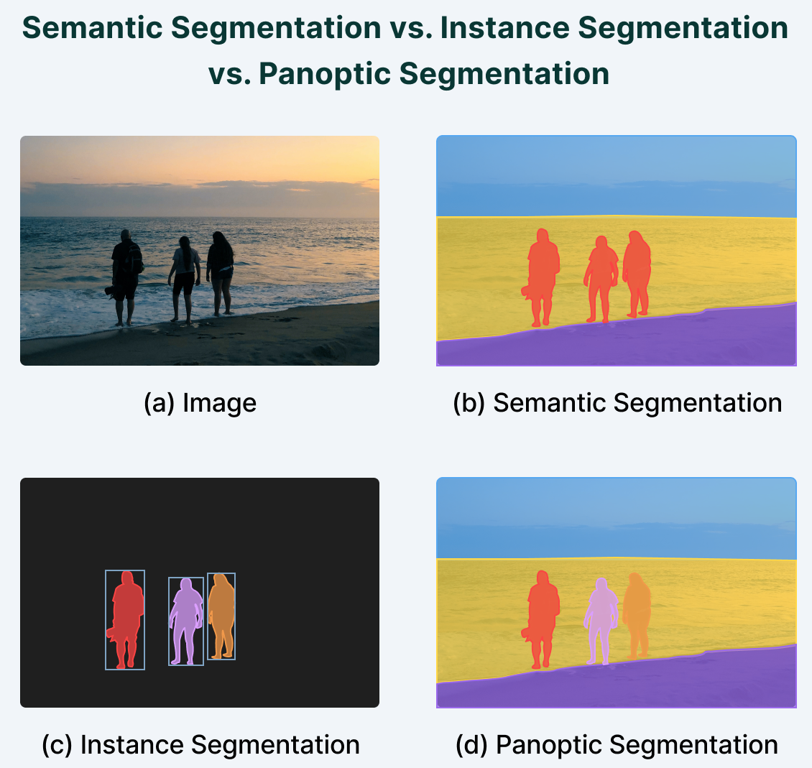
Types of Image Segmentation tasks

Slide 11
Deep Learning-based Segmentation methods
Semantic segmentation models provide segment maps as outputs corresponding to the inputs they are fed.
These segment maps are often n-channeled with n being the number of classes the model is supposed to segment.
Each of these n-channels is binary in nature, with object locations being “filled” with ones and empty regions consisting of zeros.
The ground truth map is a single channel integer array the same size as the input and has a range of “n”, with each segment “filled” with the index value of the corresponding classes (classes are indexed from 0 to n-1).

Slide 12
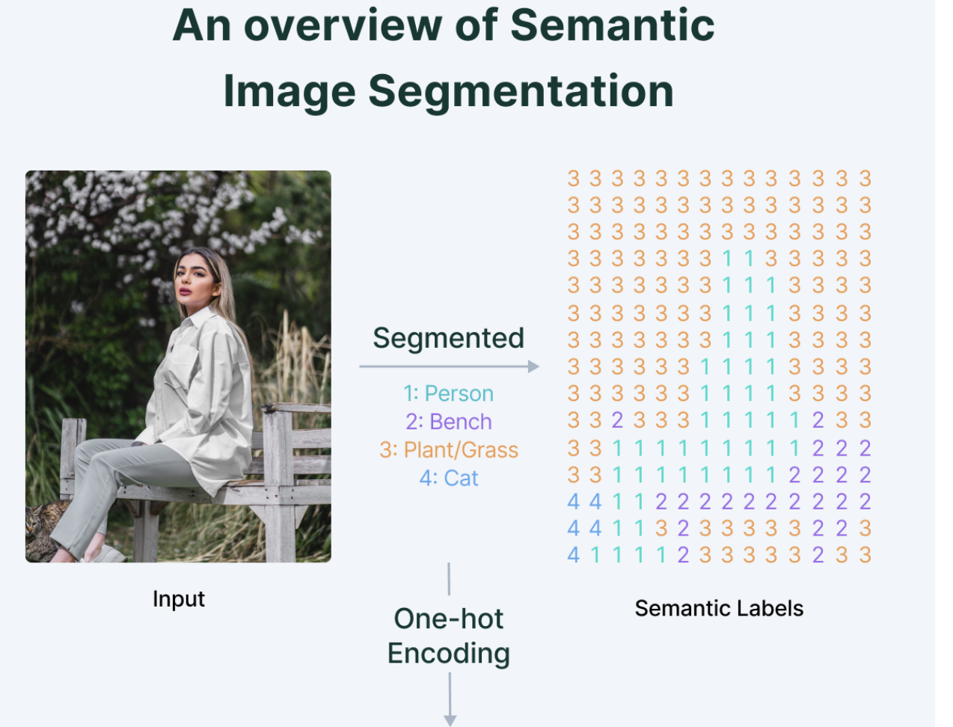
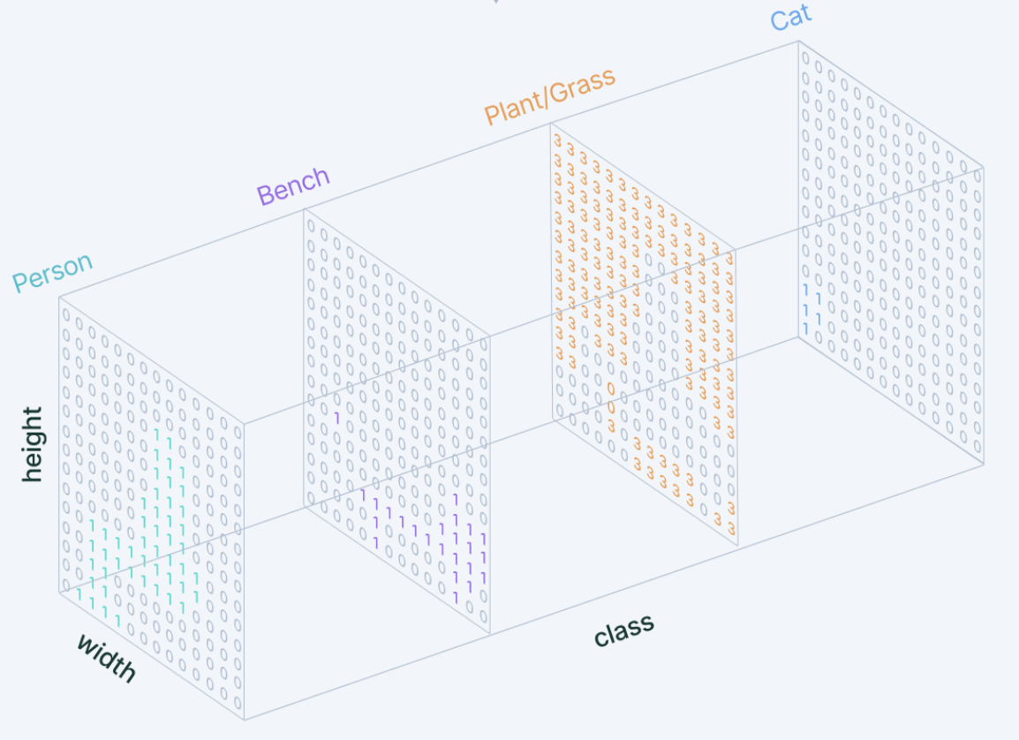
Deep Learning-based Segmentation methods

Slide 13
Deep Learning-based Segmentation methods
The model output in an “n-channel” binary format is also known as a two-dimensional one-hot encoded representation of the predictions.
Neural networks that perform segmentation typically use an encoder-decoder structure where the encoder is followed by a bottleneck and a decoder or upsampling layers directly from the bottleneck (like in the FCN).

Slide 14
Convolutional Encoder-Decoder Architecture
Encoder decoder architectures for semantic segmentation became popular with the onset of works like SegNet (by Badrinarayanan et. a.) in 2015.
SegNet proposes the use of a combination of convolutional and downsampling blocks to squeeze information into a bottleneck and form a representation of the input. The decoder then reconstructs input information to form a segment map highlighting regions on the input and grouping them under their classes.
Finally, the decoder has a sigmoid activation at the end that squeezes the output in the range (0,1).

Slide 15
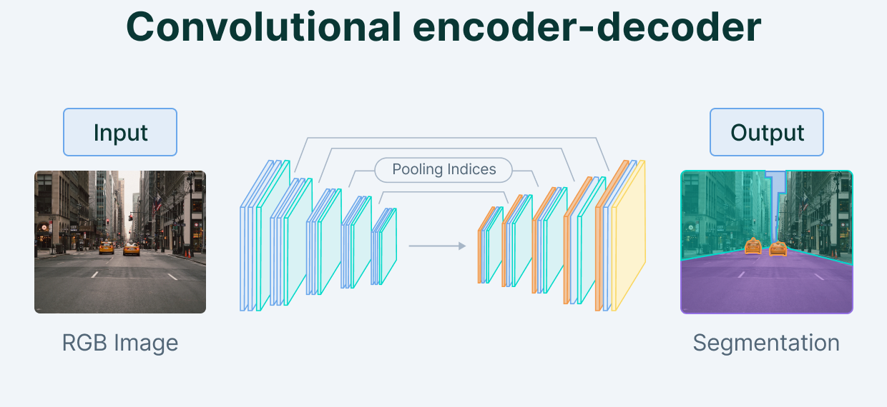
Convolutional Encoder-Decoder Architecture

Slide 16
Convolutional Encoder-Decoder Architecture
SegNet was accompanied by the release of another independent segmentation work at the same time, U-Net ( by Ronnerberger et. al.), which first introduced skip connections in Deep Learning as a solution for the loss of information observed in downsampling layers of typical encoder-decoder networks.
Skip connections are connections that go from the encoder directly to the decoder without passing through the bottleneck.
In other words, feature maps at various levels of encoded representations are captured and concatenated to feature maps in the decoder.

Slide 17
Convolutional Encoder-Decoder Architecture
This helps to reduce data loss by aggressive pooling and downsampling as done in the encoder blocks of an encoder-decoder architecture.
Skip Connections were a big hit, specifically in the domain of medical imaging, with U-Net providing state-of-the-art results in cell segmentation for the diagnosis of diseases.

Slide 18
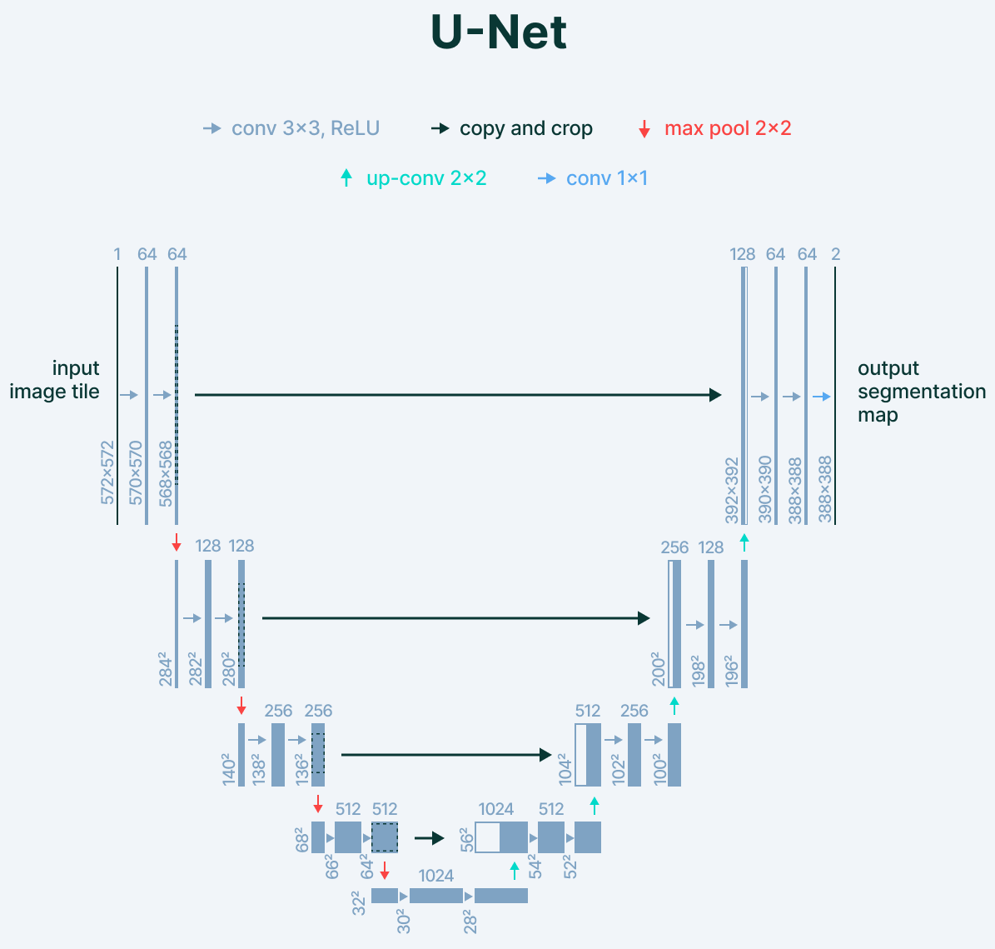
Convolutional Encoder-Decoder Architecture

Slide 19
Applications of Image Segmentation
Image segmentation is an important step in artificial vision. Machines need to divide visual data into segments for segment-specific processing to take place.
Image segmentation thus finds its way in prominent fields like Robotics, Medical Imaging, Autonomous Vehicles, and Intelligent Video Analytics.
Apart from these applications, Image segmentation is also used by satellites on aerial imagery for segmenting out roads, buildings, and trees.

Slide 20
Application in Robotics (Machine Vision)
Image segmentation aids machine perception and locomotion by pointing out objects in their path of motion, enabling them to change paths effectively and understand the context of their environment.
Apart from locomotion, segmentation of images helps machines segregate the objects they are working with and enables them to interact with real-world objects using only vision as a reference. This allows the machine to be useful almost anywhere without much constraint.
Instance segmentation for robotic grasping
Recycling object picking
Autonomous navigation

Slide 21
Application in Medical imaging
Medical Imaging is an important domain of computer vision that focuses on the diagnosis of diseases from visual data, both in the form of simple visual data and biomedical scans.
Segmentation forms an important role in medical imaging as it helps doctors identify possible malignant features in images in a fast and accurate manner.

Slide 22
Application in Medical imaging
Using image segmentation, the diagnosis of diseases can not only be speeded up but can also be made cheaper, thereby benefiting thousands across the globe.
X-Ray segmentation
CT scan organ segmentation
Dental instance segmentation
Digital pathology cell segmentation
Surgical video annotation

Slide 23
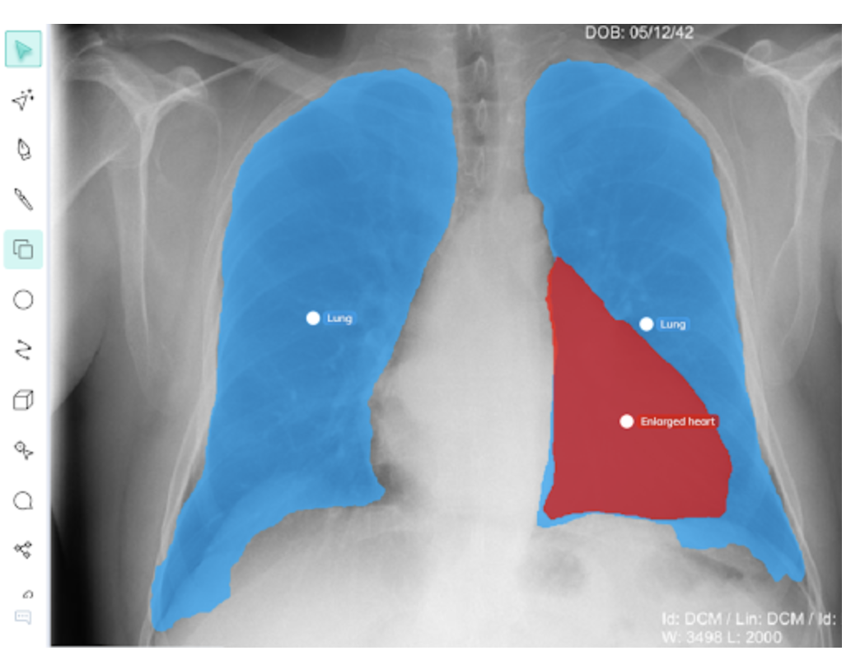
Application in Medical imaging

Slide 24
Application in Smart Cities
Smart Cities often have CCTV cameras for real-time monitoring of pedestrians, traffic, and crime. This monitoring can be easily automated with the help of image segmentation.
With AI-based monitoring, crimes can be reported faster, road accidents can be followed up with immediate ambulances, and speeding cars can be easily caught and penalized.

Slide 25
Application in Smart Cities
The use of image segmentation and AI-based monitoring can thus improve the lifestyle of people.
Pedestrian detection
Traffic analytics
License plate detection
Video Surveillance

Slide 26
Application in Self Driving Cars
Self Driving cars are one of the biggest applications of image segmentation with the planning of routes and movement depending heavily on it.
Semantic and instance segmentation helps these vehicles to identify road patterns and other vehicles, thereby enabling a hassle-free and smooth ride.
Drivable surface semantic segmentation
Car and pedestrian instance segmentation
Pothole detection and segmentation

